Slide 1
Dimensional Model - Retail

Slide 2
Dimensional Modelling - Retail Sales
Four-step process for designing dimensional models
Fact table granularity
Transaction fact tables
Additive, non-additive, and derived facts
Dimension attributes, including indicators, numeric descriptors, and multiple hierarchies
Calendar date dimensions, plus time-of-day
Causal dimensions, such as promotion
Degenerate dimensions, such as the transaction receipt number
Nulls in a dimensional model
Extensibility of dimension models
Factless fact tables
Surrogate, natural, and durable keys
Snowflaked dimension attributes
Centipede fact tables with “too many dimensions”

Slide 3
Dimensional Design Process - Select the Business Process
Step 1: Select the Business Process
A business process is a low-level activity performed by an organization, such as taking orders, invoicing, receiving payments, handling service calls, registering students, performing a medical procedure, or processing claims.
Business processes are expressed as action verds as they presents activities performed by business.
It is supported by Operational system like Billing or Purchasing Systems.
Business Process generates or captures key performance metrics either as a direct result from business or derived from events.
Business processes are triggered by an input and result in output metrics.

Slide 4
Dimensional Design Process - Select the Business Process
What happens when you design dimensional model departmentally bound dimensional models, you inevitably duplicate data with different labels and data values.
Need to decompose the business initiative into the underlying processes – digging deeper to understand the data and operational systems that supports analytical system.

Slide 5
Dimensional Design Process – Declare the Grain
Step 2: Declare the Grain
Declaring the grain means specifying exactly what an individual fact table row represents. The grain conveys the level of detail associated with the fact table measurements.
It provides the answer to the question, “How do you describe a single row in the fact table?”
The grain is determined by the physical realities of the operational system that captures the business process’s events.
Dimensional modelers sometimes try to bypass this seemingly unnecessary step of the four-step design process

Slide 6
Dimensional Design Process – Identifying Dimensions
Step 3: Identifying Dimensions
Once grain is determined, the dimensions typically can easily be identified as they represent the “who, what, where, when, why, and how” associated with the event
Common dimensions include date, product, customer, employee, and facility

Slide 7
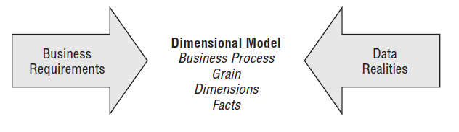
Dimensional Design Process – Identifying Facts
Step 4: Identifying Facts
Facts are determined by answering the question, “What is the process measuring?”
Typical facts are numeric additive figures,

Slide 8
Retail Case Study
Let us assume that it is Data warehouse implementation for large grocery chain with 100 grocery stores across 5 states
Each store has a full complement of departments, including grocery, frozen foods, dairy, meat, produce, bakery, floral, and health/beauty aids.
Each store has approximately 60,000 individual products, called stock keeping units (SKUs), on its shelves.
Data is collected at several places in a grocery store. Some of the most useful data is collected at the cash registers as customers purchase products.
The point-of-sale (POS) system scans product barcodes at the cash register, measuring consumer takeaway at the front door of the grocery store,

Slide 9
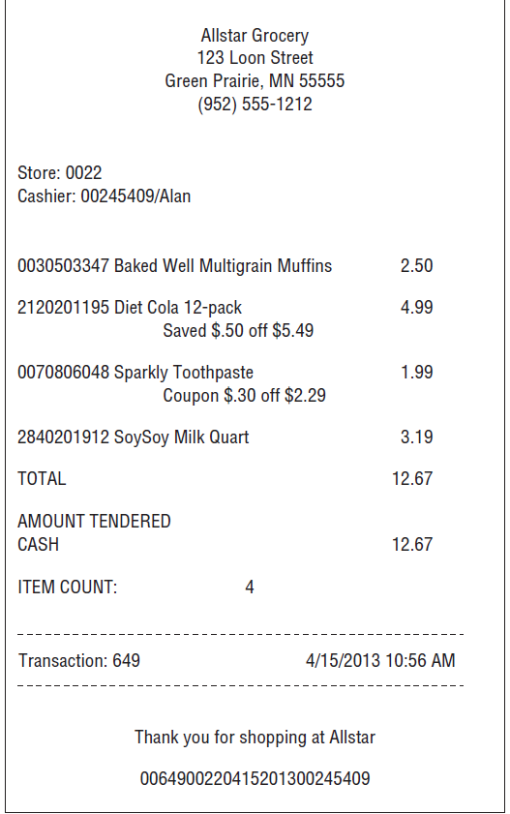
Retail Case Study
Let us assume that it is Data warehouse implementation for large grocery chain with 100 grocery stores across 5 states
At the grocery store, management is concerned with the logistics of ordering, stocking, and selling products while maximizing profit.
Profit comes from charging as much as possible for each product, lowering costs for product acquisition & overhead, and at the same time attracting as many customers.
Promotions in a grocery store include temporary price reductions, ads in newspapers and newspaper inserts, displays in the grocery store, and coupons.
But reduction in price in every cases may hit the profit directly. As a result of these issues, the visibility of all forms of promotion is an important part of analyzing the operations of a grocery store.

Slide 10
Retail Case Study - Step 1: Select the Business Process
In our retail case study, management wants to better understand customer purchases as captured by the POS system.
Thus, we need to focus on most critical business process we are modelling is POS retail sales transactions.
This data enables the business users to analyze which products are selling in which stores on which days under what promotional conditions in which transactions.

Slide 11
Retail Case Study - Step 2: Declare the Grain
Next steps is to find granularity - What level of data detail should be made available in the dimensional model?
Atomic data is highly dimensional.
In this case study, the most granular data is an individual product on a POS transaction, assuming the POS system rolls up all sales for a given product within a shopping cart into a single line item.
User are more interested to know about :
What is the difference in sales on Monday versus Sunday.
Whether to stock so many individual sizes of certain brands.
How many shoppers took advantage of the 50-cents-off promotion on shampoo?
What is the impact of decreased sales when a competitive diet soda product was promoted heavily?
None of these queries calls for data from one specific transaction but they are broad questions that require detailed data sliced in precise ways.
None of them could have been answered with summarized data only.

Slide 12
Retail Case Study - Step 3: Identify Dimensions
Next steps is to find granularity - What level of data detail should be made available in the dimensional model?
Choice of dimensions is straightforward.
A careful grain statement determines the primary dimensionality of the fact table.
We can add more dimensions to the fact table if these additional dimensions naturally take on only one value under each combination of the primary dimensions.
If the additional dimension violates the grain by causing additional fact rows to be generated, the dimension needs to be disqualified or the grain statement needs to be revisited.
We can special dimensions in certain cases like POS Transaction ID.

Slide 13
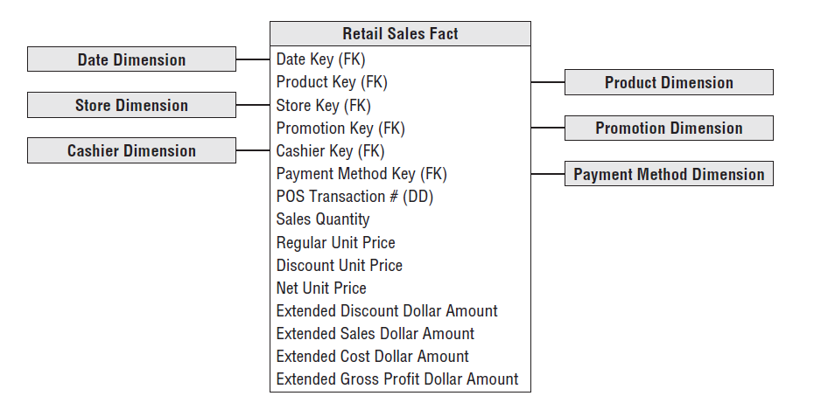
Retail Case Study - Step 4: Identify Facts
The facts must be true to the grain: the individual product line item on the POS transaction.
The facts collected by the POS system include the sales quantity (for example, the number of cans of chicken noodle soup), per unit regular, discount, and net paid prices, and extended discount and sales dollar amounts.

Slide 14
Retail Case Study – Derived Facts
Four of the facts, sales quantity and the extended discount, sales, and cost dollar amounts, are beautifully additive across all the dimensions.
We can compute the gross profit by subtracting the extended cost dollar amount from the extended sales dollar amount, or revenue.
It is suggested to store this calculated column physically. Storing means it will be computed at ETL level.

Slide 15
Retail Case Study – Non-Additive Facts
Gross margin is a non-additive fact because it can’t be summarized along any dimension. Gross margin can be calculated by dividing the gross profi t by the extended sales dollar revenue.
Unit price is another non-additive fact. Unlike the extended amounts in the fact table, summing unit price across any of the dimensions results in a meaningless, nonsensical number.

Slide 16
Retail Case Study – Transaction Facts
Transactional business processes are the most common.
The grain of atomic transaction fact tables can be succinctly expressed in the context of the transaction, such as one row per transaction or one row per transaction line.
Because these fact tables record a transactional event, they are often sparsely populated. In our case study, we certainly wouldn’t sell every product in every shopping cart.
Even though transaction fact tables are unpredictably and sparsely populated, they can be truly enormous. Most billion and trillion row tables in a data warehouse are transaction fact tables.
Transaction fact tables tend to be highly dimensional.
The metrics resulting from transactional events are typically additive as long as they have been extended by the quantity amount, rather than capturing per unit metrics.

Slide 17
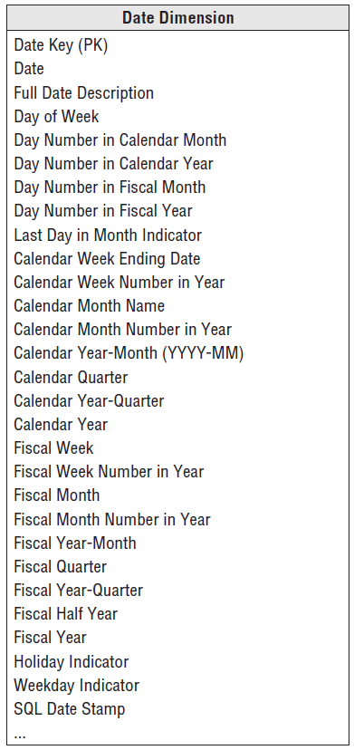
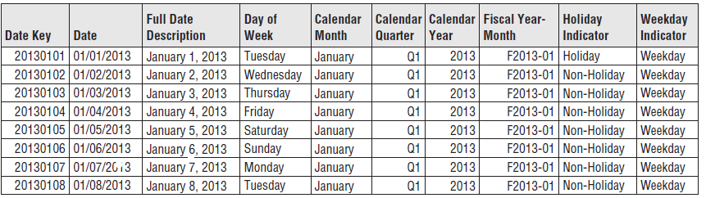
Retail Case Study – Date Dimension
The date dimension is a special dimension as it is the one dimension nearly guaranteed to be in every dimensional model since virtually every business process captures a time series of performance metrics.
In fact, date is usually the first dimension in the underlying partitioning scheme of the database
You may put 10 or 20 years of rows representing individual days in the table, so that it can cover the history as well as several years in the future.
Even 20 years’ worth of days is only approximately 7,300 rows

Slide 18
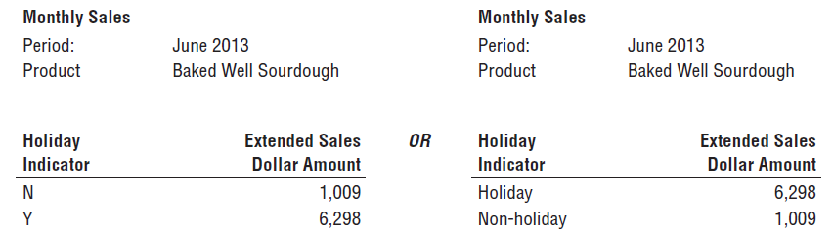
Retail Case Study – Date Dimensions - Flags and Indicators as Textual Attributes
Like many operational flags and indicators, the date dimension’s holiday indicator is a simple indicator with two potential values.
Because dimension table attributes serve as report labels and values in pull-down query filter lists, this indicator should be populated with meaningful values such as Holiday or Non-holiday.
A similar argument holds true for the weekday indicator that would have a value of Weekday or Weekend.
Imagine a report comparing holiday versus non-holiday sales for a product.

Slide 19
Retail Case Study – Date Dimensions - Current and Relative Date Attributes
Most date dimension attributes are not subject to updates
However, there are attributes you can add to the basic date dimension that will change over time, including IsCurrentDay, IsCurrentMonth, IsPrior60Days, and so on.
IsCurrentDay obviously must be updated each day; the attribute is useful for generating reports that always run for today.
Some date dimensions include updated lag attributes. The lag day column would take the value 0 for today, –1 for yesterday, +1 for tomorrow, and so on.
Like many operational flags and indicators, the date dimension’s holiday indicator is a simple indicator with two potential values.
Because dimension table attributes serve as report labels and values in pull-down query filter lists, this indicator should be populated with meaningful values such as Holiday or Non-holiday.
A similar argument holds true for the weekday indicator that would have a value of Weekday or Weekend.
Imagine a report comparing holiday versus non-holiday sales for a product.

Slide 20
Retail Case Study – Date Dimensions – Time of a Day as Dimension or Fact
Date and Time in Data Modeling
In operational systems, date and time are often stored together in a single timestamp.
For data modeling (e.g., star schema), separating time-of-day from the date dimension is recommended to avoid a huge increase in row count.
Why Avoid Time in the Date Dimension?
A date dimension with 20 years of history has about 7,300 rows.
If you added one row per minute, you'd get:
1,440 rows per day
Over 10 million rows for 20 years
If tracked per second, it would exceed 31 million rows per year.
Since the date dimension is frequently used in filters, it should be kept small and fast

Slide 21
Retail Case Study – Date Dimensions – Handling Time-of-Day Data
Use a separate Time-of-Day dimension if:
You need to filter or group by:
15-minute intervals , Hours, Shifts, Lunch hours, Prime time, etc.
This dimension might have 1,440 rows (one per minute of the day).
Skip a separate time dimension if:
You don’t need time-based grouping or filtering.
In this case, store the date/time as-is in the fact table.
Users are often more interested in:
Time lags (e.g., duration of a transaction)
Gaps between events
These can be calculated by taking the difference between two timestamps, even if the events occurred on different days, months, or years.

Slide 22
Retail Case Study – Product Dimensions
The product dimension describes every SKU in the grocery store.
Although Store may Stock 60000 SKUs, Product dimension may have 300,000 or more rows considering different merchandising schemes and historical products.
The product dimension is almost always sourced from the operational product master file.
Product master file is maintained centrally at head office and each store get subset of this file in frequent interval.

Slide 23
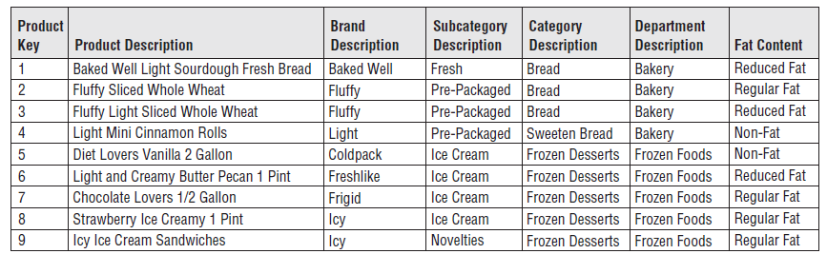
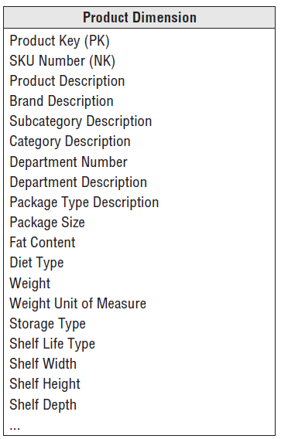
Retail Case Study – Product Dimensions - Flatten Many-to-One Hierarchies
The product dimension represents the many descriptive attributes of each SKU.
Individual SKUs roll up to brands, brands roll up to categories, and categories roll up to departments. This is many to one relationship.
Keeping the repeated low cardinality (few unique) values in the primary dimension table is a fundamental dimensional modeling technique.
Normalizing these values into separate tables defeats the primary goals of simplicity and performance

Slide 24
Retail Case Study – Product Dimensions – Other Features
Attributes with Embedded Meaning
Often operational product codes, identified in the dimension table by the Natural Key notation, have embedding meaning with different parts of the code.
For example, if the fifth through ninth characters in the operational code identify the manufacturer, the manufacturer’s name should also be included as a dimension table attribute.
Numeric Values as Attributes or Facts
Sometimes numeric values serve both calculation and filtering/grouping functions.
In these cases, you should store the value in both the fact and dimension tables.
Like the standard price in the fact table represents the valuation at the time of the sales transaction, whereas the dimension attribute is labeled to indicate it’s the current standard price.

Slide 25
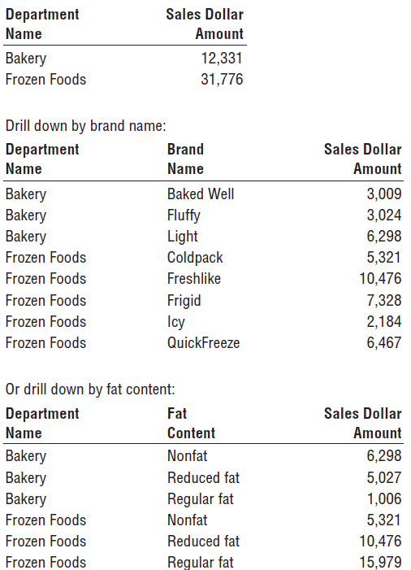
Retail Case Study – Product Dimensions – Drilling Down / Up
Drilling down in a dimensional model is nothing more than adding row header attributes from the dimension tables.
Drilling up is removing row headers.
Consider that we have a simple report summarizing the sales dollar amount by department.
If we want to drill down, we can drag any other attribute, such as brand, from the product dimension into the report next to department, and you can automatically drill down to this next level of detail.

Slide 26
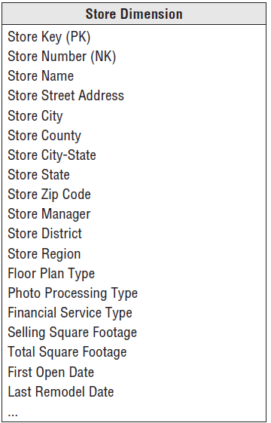
Retail Case Study – Store Dimensions
The store dimension describes every store in the grocery chain.
Unlike the product master file that is almost guaranteed to be available in every large grocery business, there may not be a comprehensive store master fi le.
POS systems may simply supply a store number on the transaction records
The store dimension is the case study’s primary geographic dimension.
Each store can be thought of as a location. You can roll stores up to any geographic attribute, such as ZIP code, county, and states.
Since many states have identically named cities, you’ll want to include a City-State attribute in the store dimension.
Stores likely also roll up an internal organization hierarchy consisting of store districts and regions.

Slide 27
Retail Case Study – Promotion Dimensions
The promotion dimension is potentially the most interesting dimension in the retail sales schema.
The promotion dimension describes the promotion conditions under which a product is sold.
Promotion conditions include temporary price reductions, end aisle displays, newspaper ads, and coupons.
This dimension is often called a causal dimension because it describes factors thought to cause a change in product sales.

Slide 28
Retail Case Study – Promotion Dimensions Factors
Promotions are judged on one or more of the following factors:
Sales Lift Did the promoted products show an increase in sales during the promotion?
- To measure this, estimate what sales would have been without the promotion (baseline).
- Baseline can come from past sales data or advanced models.
Time Shifting Did sales drop just before or after the promotion, offsetting the gain during the promotion?
- This means customers may have simply shifted their purchases to the promo period.
Cannibalization Did the promoted product’s sales increase, but reduce sales of similar nearby products?
- In this case, total category sales may not have grown — just shifted between products.

Slide 29
Retail Case Study – Promotion Dimensions Factors
Promotions are judged on one or more of the following factors:
Market Growth Did the overall product category show a net gain in sales across all time periods (before, during, after)?
- This indicates whether the promotion brought in new sales rather than just shifting them.
Profitability Was the promotion profitable after accounting for:
- The increase in sales (vs. baseline)
- Time shifting and cannibalization
- The cost of running the promotion?

Slide 30
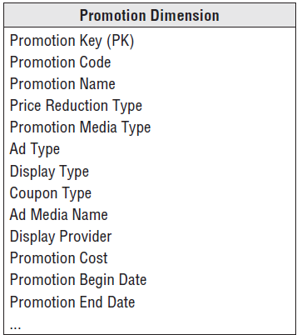
Retail Case Study – Promotion Dimensions
The various possible causal conditions are highly correlated.
We can record similar information about the promotions by separating the four causal mechanisms (price reductions, ads displays, and coupons) into separate dimensions rather than combining them into one dimension.

Slide 31
Retail Case Study – Promotion Dimensions
The trade-offs in favor of keeping the four dimensions together include the following:
If the four causal mechanisms are highly correlated, the combined single dimension is not much larger than any one of the separated dimensions would be.
The combined single dimension can be browsed efficiently to see how the various promotion conditions like price reductions, ads, displays, and coupons are used together.
The trade-offs in favor of separating the causal mechanisms into four distinct dimension tables include the following:
The separated dimensions may be more understandable to the business community if users think of these mechanisms separately.
Administration of the separate dimensions may be more straightforward than administering a combined dimension.

Slide 32
Retail Case Study – Degenerated Dimension
The retail sales fact table includes the POS transaction number on every line item
row. In an operational parent/child database, the POS transaction number would
be the key to the transaction header record, containing all the information valid
for the transaction as a whole, such as the transaction date and store identifier.

Slide 33
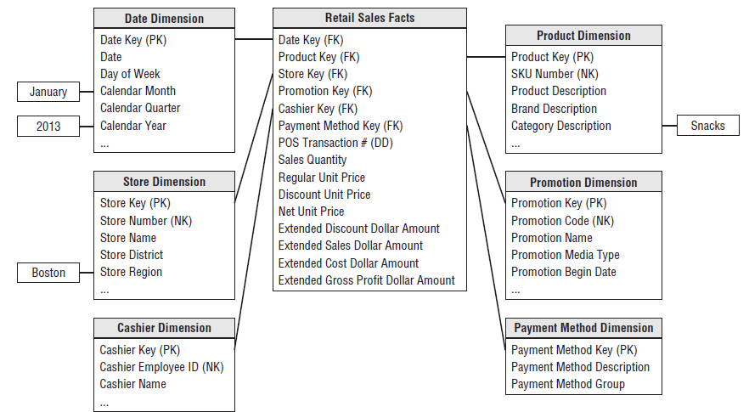
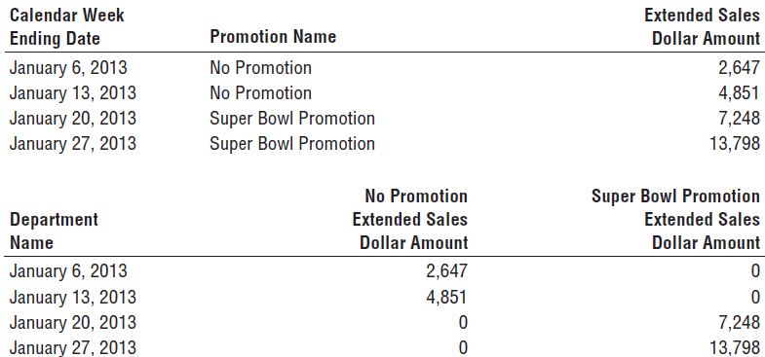
Retail Case Study – Retail Sales Schema in Action

Slide 34
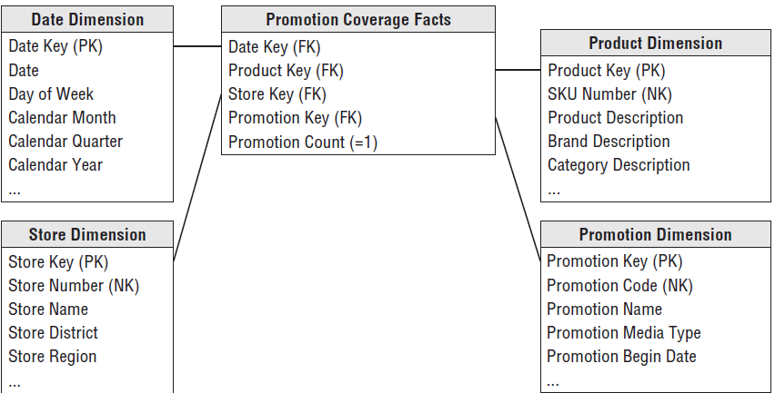
Retail Case Study – Factless Fact
What products were on promotion but did not sell?
A promotion coverage or event fact table is needed to answer the question concerning what didn’t happen
This fact looks similar to the sales fact table; however, the grain would be significantly different.
In the case of the promotion coverage fact table, we’d load one row for each product on promotion in a store each day (or week, if retail promotions are a week in duration) regardless of whether the product sold.

Slide 35
Dimension Surrogate Key
The unique primary key of a dimension table should be a surrogate key rather than
relying on the operational system identifier, known as the natural key.
Surrogate keys go by many other aliases: meaningless keys, integer keys, non-natural keys, artifi cial keys, and synthetic keys.
Surrogate keys are simply integers that are assigned sequentially as needed to populate a dimension.
Every join between dimension and fact tables in the data warehouse should be based on meaningless integer surrogate keys

Slide 36
Dimension Surrogate Key
Buffer the data warehouse from operational changes. Surrogate keys enable the warehouse team to maintain control of the DW/BI environment rather than being whipsawed by operational rules for generating, updating, deleting, recycling, and reusing production codes.
Integrate multiple source systems. Surrogate keys enable the data warehouse team to integrate data from multiple operational source system
Improve performance. The surrogate key is as small an integer as possible while ensuring it will comfortably accommodate the future anticipated cardinality (number of rows in the dimension).
Handle null or unknown conditions. As mentioned earlier, special surrogate key values are used to record dimension conditions that may not have an operational code, such as the No Promotion condition or the anonymous customer.
Handle null or unknown conditions. As mentioned earlier, special surrogate key values are used to record dimension conditions that may not have an operational code, such as the No Promotion condition or the anonymous customer.

Slide 37
Dimension Natural and Durable Supernatural Keys
The natural keys assigned and used by operational source systems go by other names, such as business keys, production keys, and operational Keys the natural key comes from multiple sources, you might use a character data type that prepends a source code, such as SAP|43251 or CRM|6539152.
In a dimension table with attribute change tracking, it’s important to have an identifier that uniquely and reliably identifies the dimension entity across its attribute changes.

Slide 38
SnowFlake Dimension and Outtrigger
The flattened, denormalized dimension tables with repeating textual values make data modelers from the operational world uncomfortable.
In product dimension table. The 300,000 products roll up into 50 distinct departments.
Rather than redundantly storing the 20-byte department description in the product dimension table, modelers with a normalized upbringing want to store a 2-byte department code and then create a new department dimension for the department decodes.
In fact, they would feel more comfortable if all the descriptors in the original design were normalized into separate dimension tables.
They argue this design saves space because the 300,000-row dimension table only contains codes, not lengthy descriptors.

Slide 39
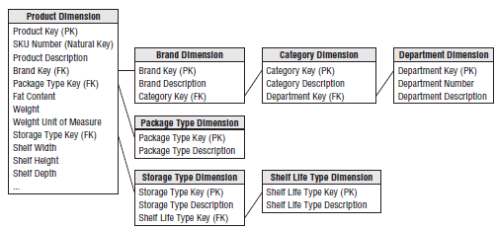
SnowFlake Dimension
Dimension table normalization is referred to as snowflaking. Redundant attributes are removed from the flat, denormalized dimension table and placed in separate normalized dimension tables.

Slide 40
SnowFlake Dimension
Snowflake is a complex dimensions as it increases joins.
It may save diskspace which is insignificant compare to effort and cost of query
Fixed depth hierarchies should be flattened in dimension tables.
Normalized, snowflake dimension tables penalize cross-attribute browsing and prohibit the use of bitmapped indexes.
Disk space savings gained by normalizing the dimension tables typically are less than 1 percent of the total disk space needed for the overall schema. You should knowingly sacrifice this dimension table space in the spirit of performance and ease of use advantages.

Slide 41
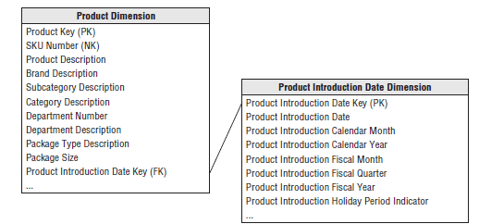
Outrigger
The outrigger date attributes are descriptively and uniquely labeled to distinguish them from the other dates associated with the business process.
It only makes sense to outrigger a primary dimension table’s date attribute if the business wants to fi lter and group this date by nonstandard calendar attributes, such as the fiscal period, business day indicator, or holiday period.

Slide 42
